Slide 1
Change Auditor (CA) Training Class 1

Slide 2
Welcome to CA Training Class #1
Class Goals:
To give students an understanding of the role of CA in their Enterprise environment.
Ensure every student fully understands how to install, configure and work with CA at the conclusion of the class 1
Spend more time “Doing” versus “Watching”
Suggested Pre-requisites:
Active Directory Administration
Knowledge of Microsoft Exchange

Slide 3
Class Structure
Familiarize yourself with your server environments (Once)
Establish access to software and knowledge base (Once)
Instructor lead lecture and discussions (Alternating)
“Hands-On” Labs (Alternating)
Lab Competency Test at the end of each lab (Alternating)

Slide 4
CA Class 1 Lecture and Lab Schedule
Overview of Change Auditor and the role it has in reporting on your Active Directory and Exchange Environments
Planning your CA configuration (Architecture)
Install Coordinator and Client
Install Agents
Option Specific Usage
Phase 1 (Client Overview)
Phase 2 (Custom Searches and Alerts (generic))
Phase 3 (Active Directory)
Phase 4 (Exchange)
Phase 5 (File Servers)

Slide 5
First Things First…
Every Student will be assigned:
1 Windows Server with MS SQL and Reporting Services already installed to act as our client machine
1 Domain Controller for domain TRAIN31
1 Exchange 2010 Server
Each Student’s servers will be independent from one another.
Access to the CA client, DC and Exchange servers will be via RDP to more closely mimic production environments.
Students will be required to create a support.quest.com account (or login if you already have one) via the client machine to ensure you have connectivity.

Slide 6

CA Class 1 LAB 1
Login to the computer you have been assigned
Go to the folder on your desktop entitled CA Class 1
Open the document called Lab1Guide.pdf and follow the instructions.
In the event you are unsure about how to execute a particular lab exercise we have also included a reference sheet for each lab showing graphically what is being asked for.
During the lab I will visit each student’s session to ensure all is going well and there are no questions.
If you have a question while I am helping someone else click on the icon at the front right corner of your screen (see example below), hit chat, and I will answer / rejoin you shortly.
Lab Time 30 minutes

Slide 7
CA 1 LAB 1 Exercises
Logon to your 2008 Server with account Student and password leadthem
Open up Internet Explorer and go to the support.quest.com website.
Login to ensure you have access to the Quest knowledge base and software downloads.
If you don’t have a login create one.
Retrieve and write down your local IP address and machine name by which ever method you prefer (command prompt, system tools, etc)
192.168.123.xxx
ITARSA
From the command prompt ping the other servers in your set using machine name to verify DNS functionality and connectivity. Note each system’s IP address. The system names are ITARSB and ITARSC31.

Slide 8
CA 1 LAB 1 Exercises Continued
Login to the DC via RDP with the account admin and password leadthem.
Using standard tools (Active Directory Users and Computers) locate the OU ‘Service Accounts’. Once there verify the user account CAService is present and that it is a member of the Domain Admins Security Group. Once completed logoff of the Domain Controller.
Now logon to the Exchange server via RDP with account ExAdmin and password leadthem verify that you can log onto the server and that the account is a member of the Organization Management security group.
After exiting out of both systems, verify that CAservice and Student accounts are both members of the local Administrators on your local machine (ITARSA).
System Breakdown
Your Server (Client) Domain Controller Exchange Server
ITARSAxx ITARSBxx ITARSCxx

Slide 9
Why Change Auditor?
Change Auditor helps answer the fundamental questions that both administrators and auditors have. Specifically, what changes have been made and who made the change. With change auditor we have those answers.

Slide 10
Change Auditor Overview
Change Auditor provides a total auditing and security package covering your Microsoft infrastructure in areas like Active Directory, Exchange, File Servers, and even local users. Providing administrators, auditors, managers with the information each needs, in a format that each can use.
Audit critical changes across the enterprise
Automate compliance tracking and reporting
Enhance troubleshooting with up-to-the-moment views into what is happening in the enterprise
Automated alerting with built-in and custom audit alerts
Reporting that is valuable to Auditors, Managers, and Administrators
Protection (lockdown) of critical AD objects, Exchange mailboxes, and business-critical files and folders

Slide 11
Change Auditor Overview (Active Directory)

Slide 12
Change Auditor Overview (Exchange)

Slide 13
Change Auditor Overview (File Servers)

Slide 14
Lab 2 – Coordinator installation
Log on to your assigned workstation using the Student account that you used in the previous lab.
Open the CA Class 1 Folder, then the Lab 2 folder.
Open the Lab2Guide.pdf document
Open the CA Install folder.
Double Click ‘autorun.exe’
Select the Install tab

Slide 15
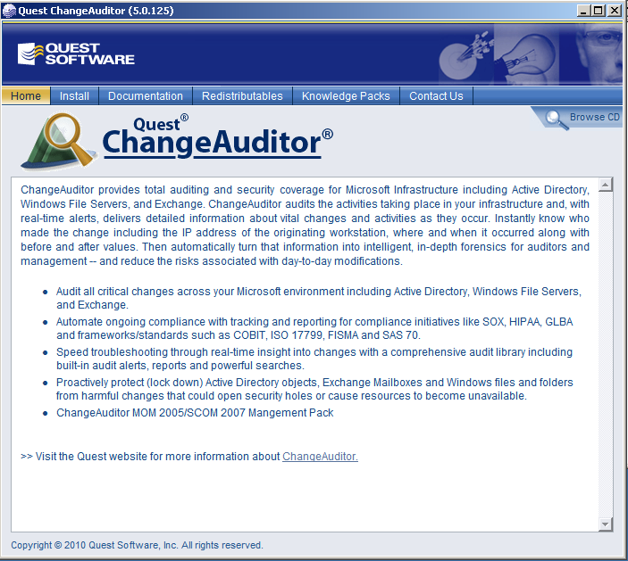
Lab 2 – Coordinator installation
Click on Install ChangeAuditor Coordinator – x64

Slide 16
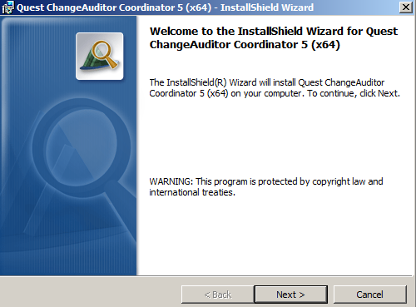
Lab 2 – Coordinator installation
Choose Next on the First Install Screen

Slide 17
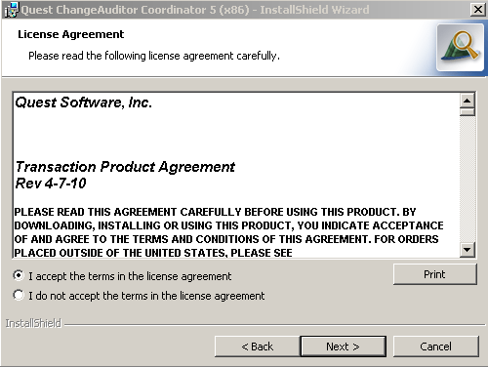
Lab 2 – Coordinator installation
Select Next once you accept the license agreement.

Slide 18
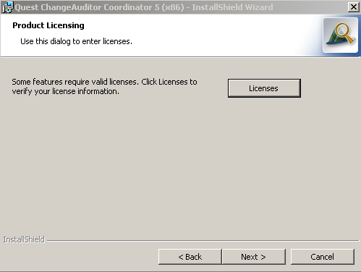
Lab 2 – Coordinator installation
Select the Licenses button.

Slide 19
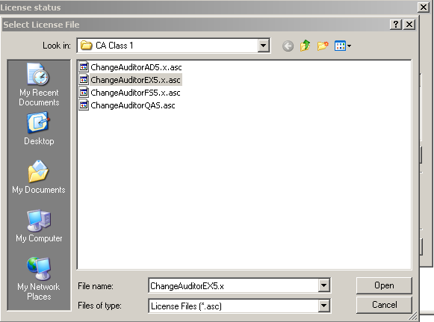
Lab 2 – Coordinator installation
Next click the “Browse license…” button and choose the licenses found in the “CA Class 1” folder.

Slide 20
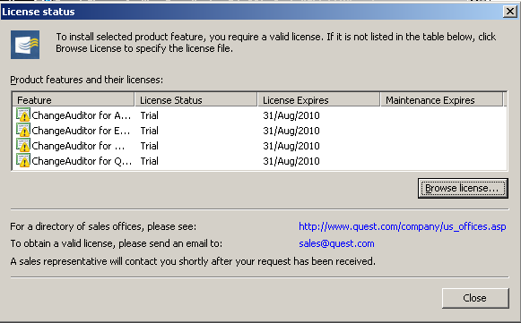
Lab 2 – Coordinator installation
After adding each of the individual licenses your license status screen should display each of the licenses selected.

Slide 21
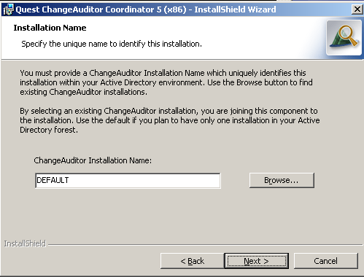
Lab 2 – Coordinator installation
Once you click close on the license status screen, you will return to the product licensing screen; click Next.
The next screen allows us to choose the name of our coordinator instance; if you will only have one in your environment, then default is fine; if you expect to install several, maybe controlled by different departments, you would choose a different name here. You can also install a coordinator as part of an existing installation.

Slide 22
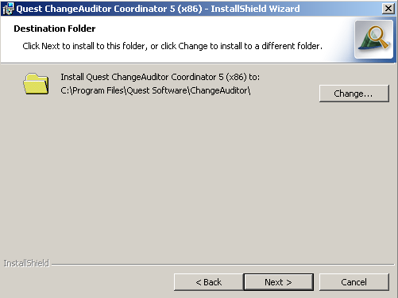
Lab 2 – Coordinator installation
The next screen allows for customization of the installation location. For our purposes, we will use the default.

Slide 23
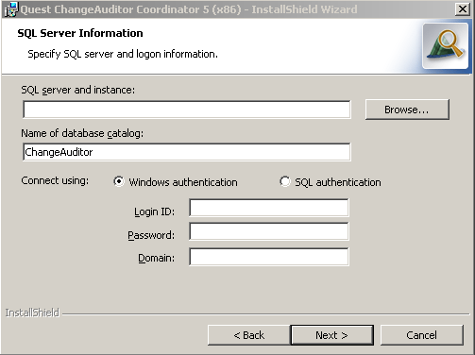
Lab 2 – Coordinator installation
The next screen sets up our connection to SQL Server.

Slide 24
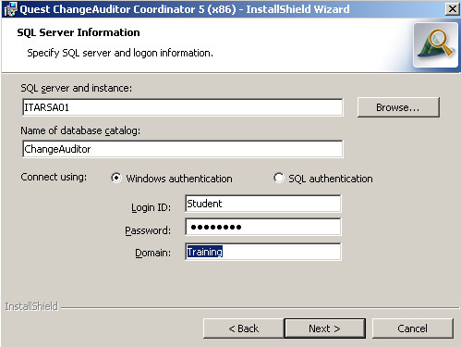
Lab 2 – Coordinator installation
Enter the name of your local machine and the service account credentials that you created in the previous lab.

Slide 25
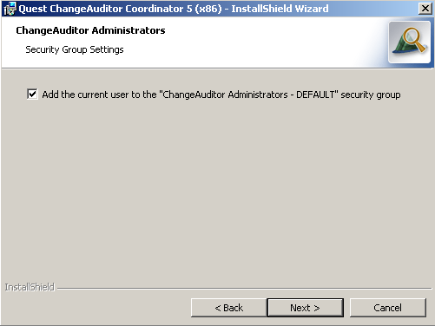
Lab 2 – Coordinator installation
Make sure to check this box to allow the current user full access to managing your ChangeAuditor installation.

Slide 26
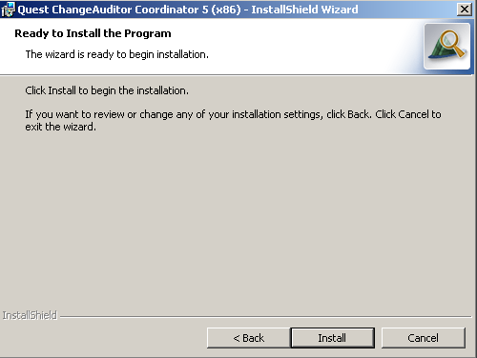
Lab 2 – Coordinator installation
Once this section is completed click “Install” and begin the installation.

Slide 27
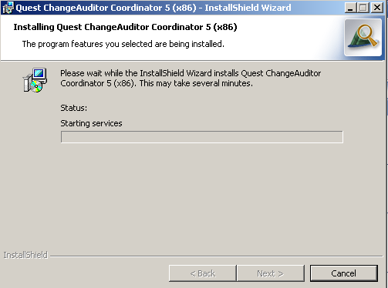
Lab 2 – Coordinator installation

Slide 28
Lab 2 – Client Installation
Logoff of the CAService account
Logon using the Student account that you worked with originally.
Open the CA Class 1 Folder, then the Lab 2 folder.
Open the Lab2Guide.pdf document
Open the CA Install folder.
Double Click ‘autorun.exe’
Select the Install tab

Slide 29
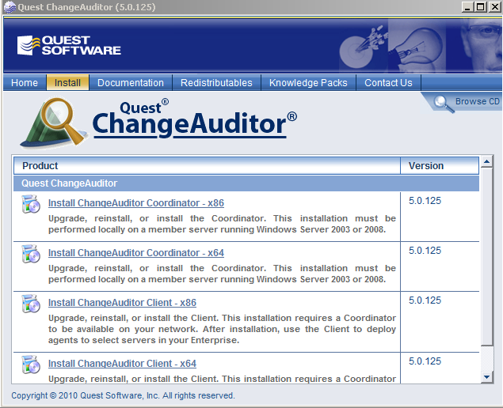
Lab 2 – Client Installation
Click on Install ChangeAuditor Client – x64

Slide 30
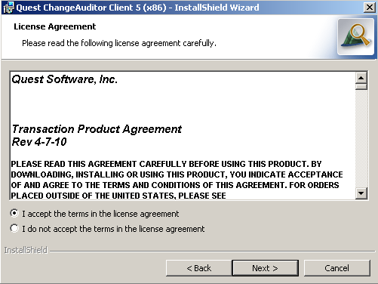
Lab 2 – Client Installation

Slide 31
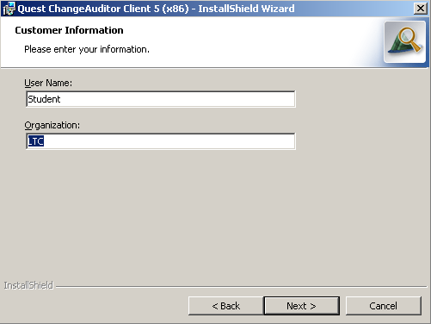
Lab 2 – Client Installation

Slide 32
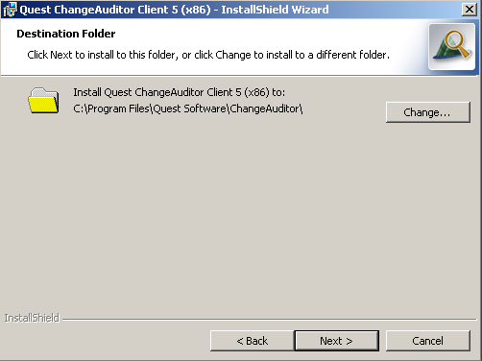
Lab 2 – Client Installation

Slide 33
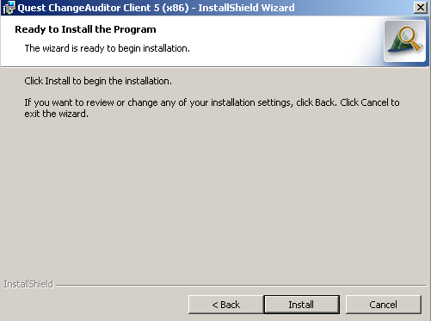
Lab 2 – Client Installation

Slide 34
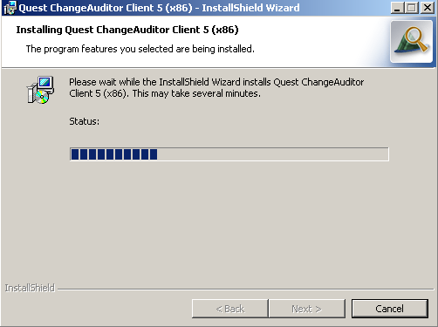
Lab 2 – Client Installation

Slide 35
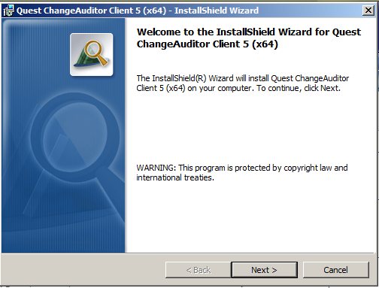
Lab 2 – Client Installation
Once you reach the final screen click “Finish”, and the client installation is completed.

Slide 36
ChangeAuditor Client Overview
First Steps
Define Connection Profile
Install Agents on Member Server (local machine); Domain Controller (Machine B); and Exchange Server (Machine C)
Review Agent Status
Understand the Overview tab
Review Built-in Reports
Review Built-in Alerts.

Slide 37
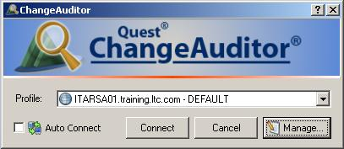
ChangeAuditor Client Overview
After opening ChangeAuditor Client we need to define a connection profile.

Slide 38
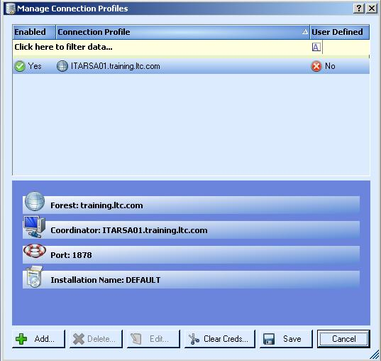
ChangeAuditor Client Overview
Clicking the “Manage” button brings up the connection management screen.
Notes:
This screen allows for the setup of multiple connections, we will be using the default.
Cover items shown on the screen.

Slide 39
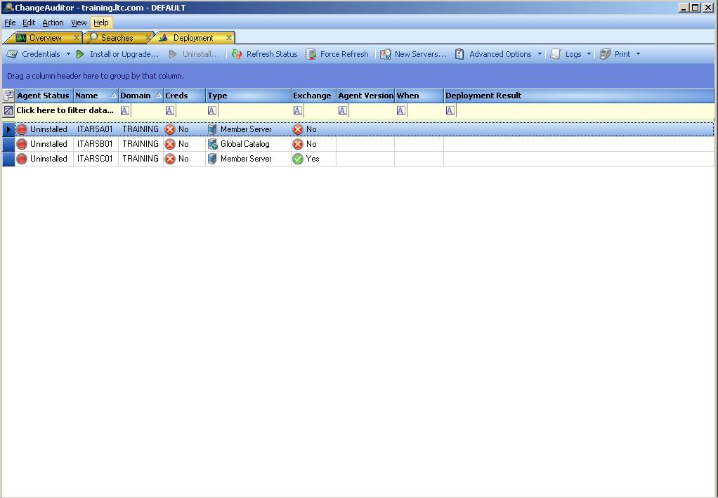
ChangeAuditor Client Overview
Upon connecting for the first time, the client will open to the deployment screen.
Notes:
Walk through the screen items:
Display list (uninstalled, etc)
Credentials…
Install or Upgrade…

Slide 40
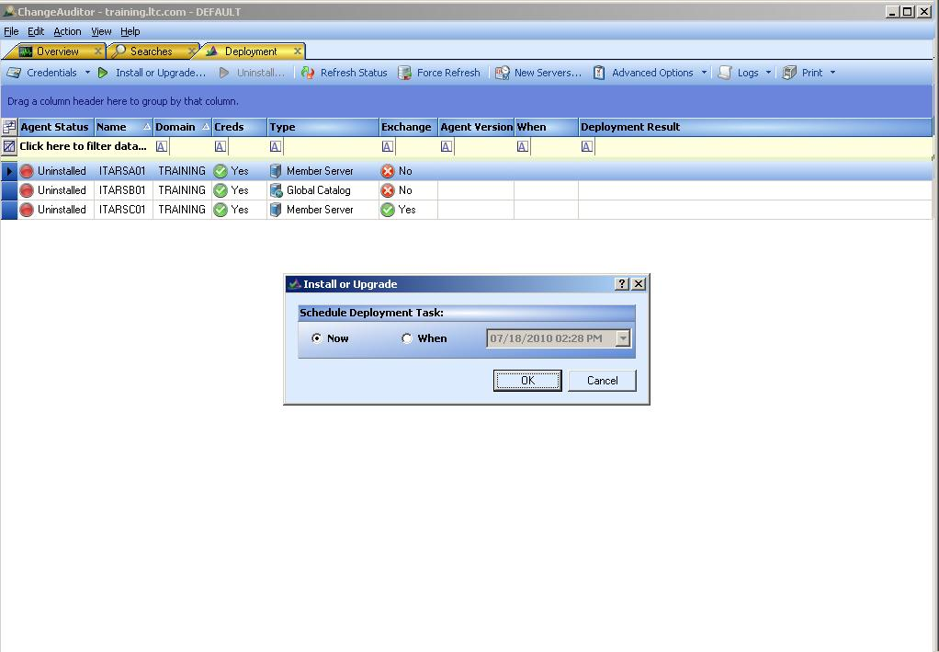

ChangeAuditor Client Overview
Note the credentials have now been set…
Notes:
Note that all remain uninstalled.
Credentials are set
Allows for immediate or timed installation of agents.
Only highlighted servers is set to be installed.

Slide 41
ChangeAuditor Client Overview
There are a series of tabbed pages providing information available in the CA client window. Here are highlights from a few of those.
*Overview – Provides immediate feedback concerning your “favorite” search; status of agents; top agent activity; etc.
*Searches – Provides information on the “built-in” searches; ability to create new custom searches; ability to run “built-in” or custom searches; define favorite searches; work with alerts; view alert history; and publish reports.
Search Results – View the results of searches; view event details; Compare results side-by-side; print results.
Agent Statistics – Review status and properties of each agent; stop, start, and restart agents.
* Tabbed pages that are available immediately upon open CA Client.

Slide 42
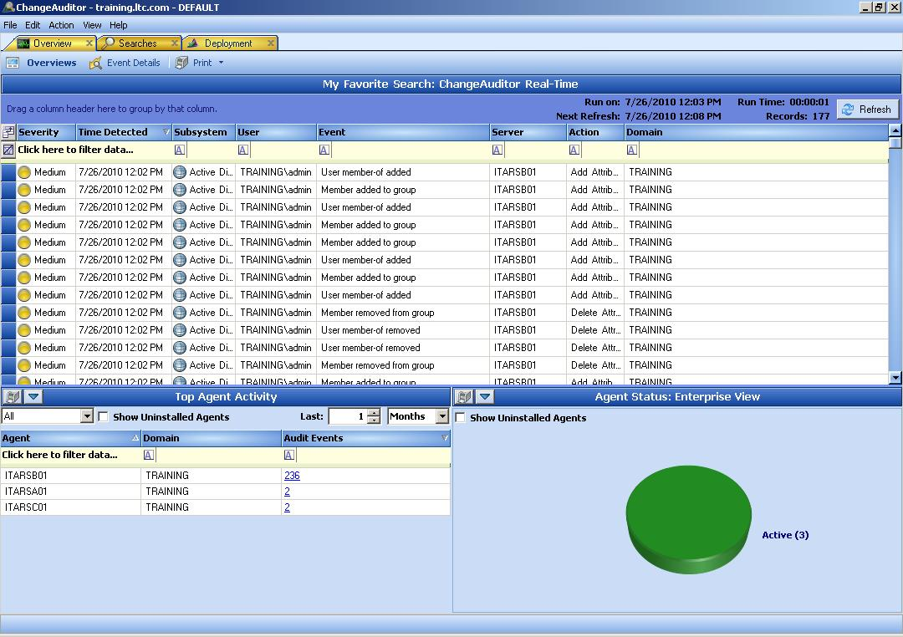
ChangeAuditor Client Overview
Notes:
Review the three main sections of the overview page
Favorite Search
Top Agent Activity
Agent Status

Slide 43
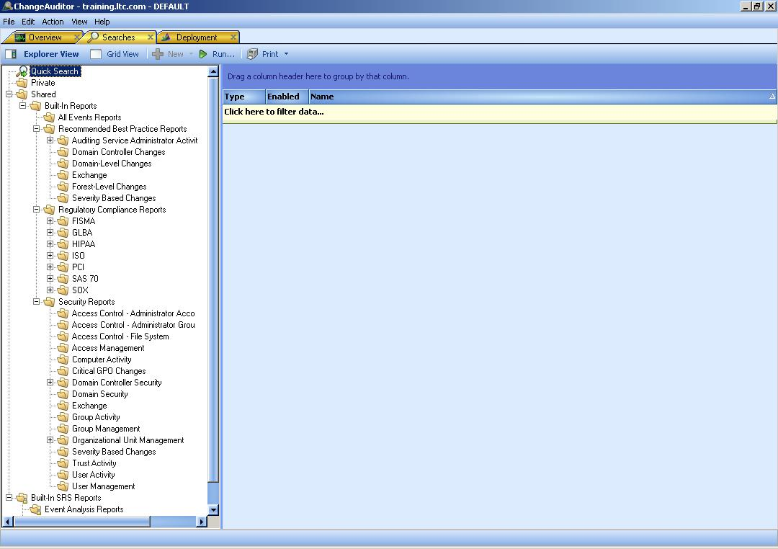
ChangeAuditor Client Overview
Notes:
Searches tab
Review built-in searches
Customized searches are created here
Printing searches

Slide 44
CA Class 1 Lab 3
In this lab we’ll familiarize you with the ChangeAuditor Client. In addition, we will deploy agents and initialize activity on Active Directory.
Log on to your server with the Student account, and from the desktop open “CA Class1” then “Lab 3”
RDP to ITARSBxx and login with Admin and the password leadthem.
Using Active Directory Users and Computers open the properties of the group ChangeAuditor Administrators – DEFAULT and add the Student account.
Log off of ITARSBxx.
Start -> All Programs -> Quest Software -> ChangeAuditor -> ChangeAuditor Client
This will open the Connection Profile Screen. (For Review click on “Manage…”)
Once you have taken the time to review this screen click cancel to get back to the connection screen.
Click “OK” to enter the Client software.
Once entered you should be on this screen. If not click on the deployment tab, or if that is not available, click View->Deployment
Click on “Credentials” to setup the account information required for installing agents.
Click “Set” and then enter the username admin and password leadthem. Then click “OK”.

Slide 45
CA Class 1 Lab 3
Now click “OK” to return to the main credentials screen. Note that “Yes” is now listed under credentials.
After Clicking OK you will note that all systems listed now show “Creds” are set. Now, highlight ITARSAxx and then click on “Install or Upgrade…”
The pop-up allows you to schedule the install for a specific time, if desired. We will choose “Now” and click OK.
The deployment screen maintains the agent installation status. Once this completes, highlight the other servers and install “Now” on those systems.
Upon completion the following screen shows all agents installed and operational. We will now click on the Overview tab to continue.
Take a moment to look around this screen. You should note that it is unlikely you show any information in the “Favorite Search” section. Therefore, at this point we need to create some AD information to work with.
Connect back to the domain controller “ITARSBxx” and logon with username Admin and password leadthem.
Double click the ‘CA Class – AD Activity’ shortcut on the screen.

Slide 46
CA Class 1 Lab 3
Once screen shows the line “About to delete x objects” then close the cmd prompt by clicking X in the upper right corner; then repeat the process, at least 3 times.
Now close these windows and log off of itarsbxx. You should be returned to your main CA screen with data on the main page.
View the lower left screen “Top Agent Activity” and click on the number listed for ITARSBxx. This will open a search results screen showing the same activity on your Overview screen. Note that the data is arrived at in different ways. The current favorite is all recent activity, while the results screen we now see gives all data for a month from this particular server. Click the x to close the tab when you are finished with this review.
Back at the main screen, if your agent installation was successful for all servers the lower right corner of the screen should be an all green pie chart.
To verify data information, open a command prompt and enter the command “net stop NPSrvHost”. This should stop the local ChangeAuditor Agent.
Hit the F5 key to refresh the entire screen.
Now we need to restart the service. “Net start NPSrvHost”
Exit the command prompt and hit F5 again to refresh your ChangeAuditor view.
Next click on the Searches tab. Now expand the tree to Shared -> Built-In Reports -> Security Reports -> User Management. Once you highlight User Management a list of reports falling under this section will appear on the right.

Slide 47
CA Class 1 Lab 3
Double click the “Users added to group in the last 30 days” to retrieve this report in a results tab labeled by the report that you have run.
Choose a line in the report and double click to get the event details (Clicking the “Event Details” button gives you the same result). Remember the details screen gives us the 4 Ws (Who, What, When, and Where).
Now close the “Users added to group …” tab and return to the “Searches” tab. Here click on the “All Events Reports”. Now find the “All User Events” search in the right pane.
This time, after verifying that the “All User Events” search is highlighted, click “Run” to execute the search…
With this search, we will dig a little deeper. Drag the column header “Event” to the dark blue section just above the search to group the search by event type.
Now that we have grouped by one of the columns we can change our view by clicking on the pie chart.
Or the bar graph icon just to the right of the pie chart icon.
Now switch back to the standard view and right click on the Event header and choose unGroup. You can also drag the Event button back to its place or a different place among the column headers.

Slide 48
CA Class 1 Lab 3
Now we will filter data to only show the information we want. By clicking the drop-down list just below the “Event” header to choose an event to view.
Finally, lets close this search results page. Now back on the Searches page, we will make the “All User Events” search our “Favorite”. To do so, right mouse click on the search you just worked with and select “Set As My Favorite”.
Now to review this change, go back to the “Overview” tab and click refresh. You should now see the results of the search you just set.
To switch it back to the original, go back to the searches tab and traverse the tree to Shared -> Built-In Reports. Then right click on the “ChangeAuditor Real-Time” search, and choose “Set As My Favorite”. Feel free to set the favorite to the report of your choosing.
Now take Lab test 3

Slide 49
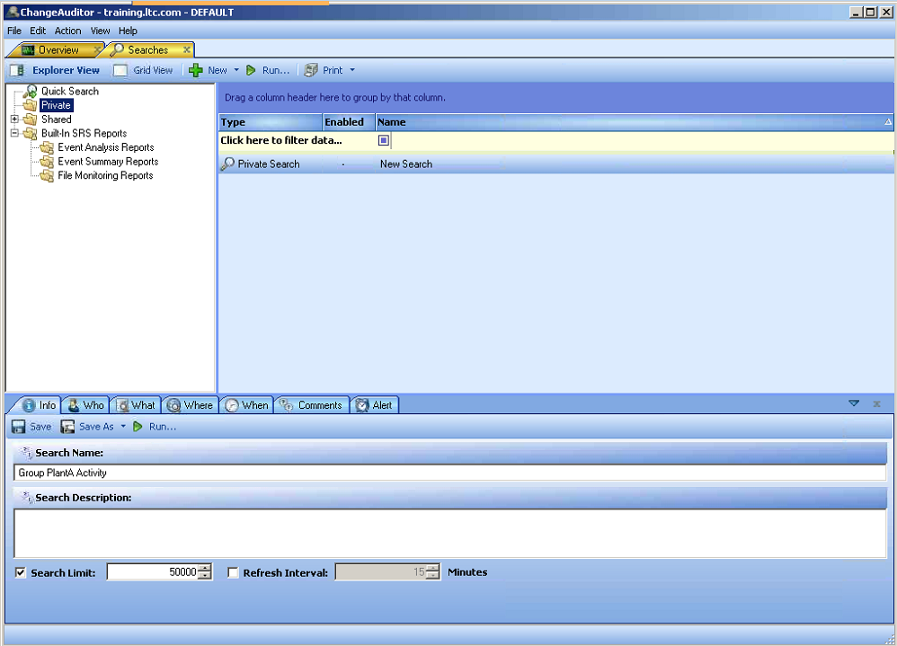
CA Class 1 Custom Searches and Alerts.
We are going to walk through the configuration of a custom search.
Notes:
Review the difference in the Private and Shared sections.
Review the 4 W that define a search.
Talk about what we want the search to accomplish.
Review all users who are added or removed from the PlantA security group.

Slide 50
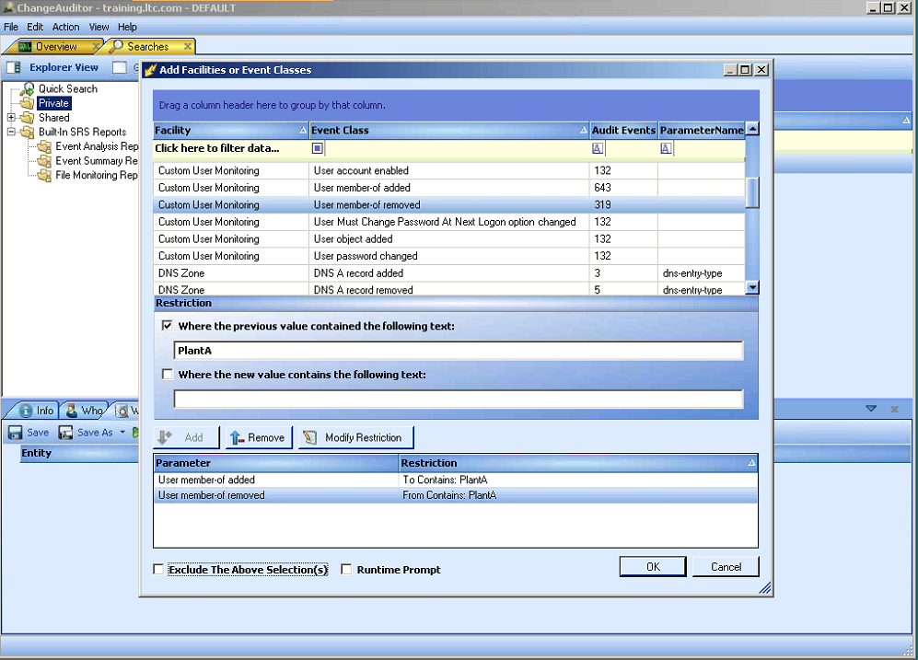
CA Class 1 Custom Searches and Alerts.
The choice shown must reflect what the event will give. So if the membership is removed, you must put the group on the previous value.

Slide 51
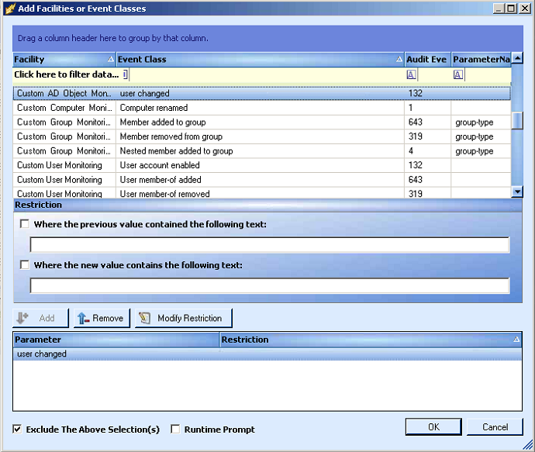
CA Class 1 Custom Searches and Alerts.
We are gathering information from the user and group object so we are getting 2 events for each action.
Notes:
Select the User changed event class and set it to excluded.

Slide 52
CA Class 1 Custom Searches and Alerts.
Alerts
Provide a real-time alerting of events happening within you network.
Can be created based on any search, built-in or custom.
Generally will be sent via an smtp connection.
Using “Smart Alert”, the created alert can be based on a number of events occurring in a specific period of time.
Once enabled as an alert the alert history becomes available.

Slide 53
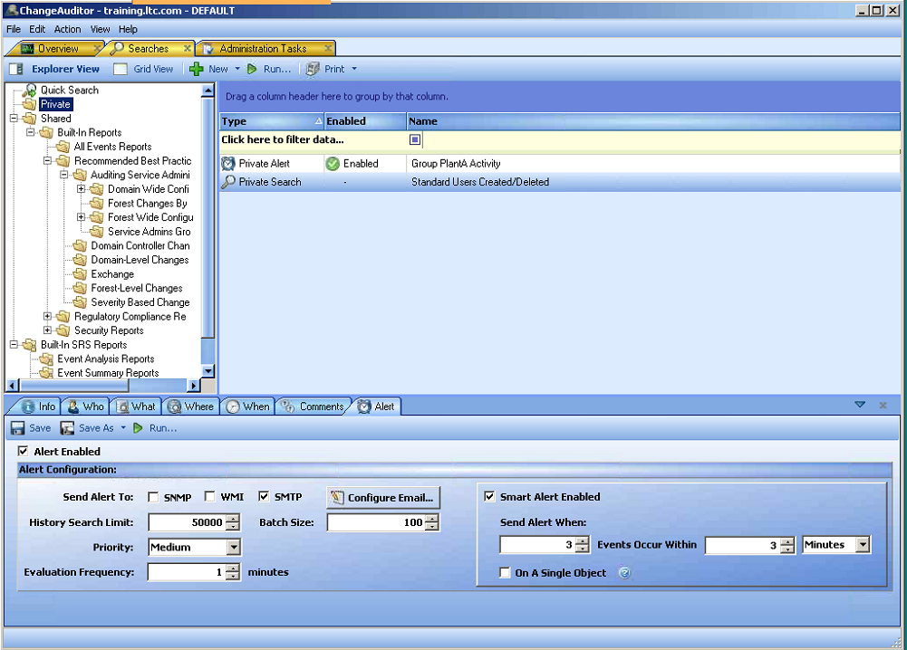
CA Class 1 Custom Searches and Alerts.

Slide 54
CA Class 1 Lab 4
Custom Searches
We will create the custom search that was done in class. Close the “All User Events” search result tab. Right mouse click on the “Private” folder in the tree and choose New-> New Search.
This opens the Search creation section (also known as Search Properties). For Search Name enter “Group PlantA Activity”.
Click on the What Tab and click on the “Add With Events” button. Now select the “User member-of added” Event Class. Once that is complete we need to add a restriction. Since this event is adding group membership, the “Where the new value contains the following text” should be PlantA. Once entered, click on Add and select “Add this Event”.
Now repeat the process with the Event Class “User member-of removed”. Remember that in this case the group in question will be the previous value.
Click “OK” then “Save” to save your new search.
Run your search to verify that you have some data. The AD activity we did should have included this group.
Now let’s create another custom search. Close the Group PlantA Activity tab. Right click again on Private and select New -> New Search. Name this search “Standard Users Created/Deleted”

Slide 55
CA Class 1 Lab 4
Again, we will switch to the What tab. Here, click Add and select Subsystem -> Active Directory.
On the “Add Active Directory Container” page, select “This Object and Child Objects only”, then browse Active Directory and find the “Location/Arizona/Users” OU. Now, we also said that we only want to report on creation and deletion. Therefore, in the Action and Results section we need to uncheck all actions except “Add Object” and “Delete Object”. Once set click the “Add” button. Now repeat for Location/Oklahoma/Users and Location/Oregon/Users.
Click “OK” and then save on the main searches screen.
Right click on the newly saved search and click Run. While reviewing the results you may note that there are two entries for each account.
When reviewing the Event section we find that there is a user changed in addition to User object added and User object removed. So let’s filter that user changed event out of our search. To do that click “Search Properties” and click on the What tab. Note the Active Directory entry that we created with our search.
Click on the “Add With Events” button and choose user changed from the event class list. Select Add -> Add this Event. Finally check the “Exclude the Above Selection(s)” check box.

Slide 56
CA Class 1 Lab 4
Click OK, Save, then Run. Now you should have a cleaner listing of created and deleted objects.
Alerts
First, we need to enable SMTP for alerts. To do this, click on View -> Administration. This will open the Administration Tasks tab. Under configuration on the left select Coordinator.
Check Enable SMTP for Alerts and fill in the remainder of the information:
Mail Server ITARSCxx
From Address: ca@trainxx.ltc.com
Reply to: student@trainxx.ltc.com
Now switch back to the searches tab and view the “Private” searches. Right click on Group PlantA Activity and choose Alert -> Enable -> SMTP.
Answer yes to the first pop up; and fill in student@trainxx.ltc.com on the second.
Now you should see that the type has changed from private search to Private Alert.

Slide 57
CA Class 1 Lab 4
Now we will create an alert in a different way. Click on the Private Search Standard users Created/Deleted. Now at the bottom of the screen choose the Alert Tab. Choose SMTP on the send alert to choices. Once again fill in student@trainxx.ltc.com. Now that that is selected, you can enable the alert. Now for this one, we will enable the Smart Alert and set it at 3 events in 3 minutes.
Save the alert. Open outlook, and verify that you are connected to Exchange. Now open an RDC connection back to itarsbxx and run the CA Class – AD Activity. This should produce some alerts for you.
Now take the Lab 4 Test.

Slide 58
CA Class 1 Active Directory
Active Directory License unlocks several features.
Built-In Active Directory searches
Auditing of Active Directory Events
Auditing of any Active Directory Object
Auditing with specific severity level for any object attribute
Three default audited objects
User
Computer
Group
Default audited attributes are added, removed, moved, and renamed. These do not show in the Monitored Attributes count.
Ability to protect AD objects.

Slide 59
CA Class 1 Active Directory
Active Directory protection allows any object in AD to be protected at whatever level you choose. Some examples are:
Protect administrative groups from change, except by the specific user
Protect specific OUs from accidental deletion.
Protect specific objects attributes from being changed.
A Few items to keep in mind when protecting objects:
Protecting all objects is NOT standard practice.
Lock only critical objects.
User objects need some attributes updated for normal operation.
Protecting a user object does not keep a user from being added to a group.

Slide 60
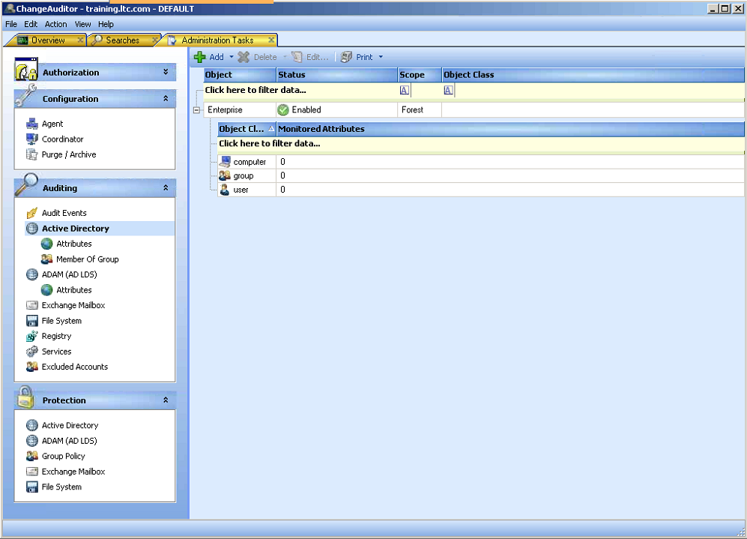
CA Class 1 Active Directory
Default Setup

Slide 61
CA Class 1 Lab 5
AD Auditing
Open ChangeAuditor Client. If the “Administration Tasks” tab is not available click View->Administration. In the Administration Tasks tab; Click on Active Directory under Auditing. You can then view the currently audited object classes, along with the number of monitored attributes.
Prior to making any changes, we want to verify what we receive currently. First, right click on the ADUC shortcut on the desktop and choose run as… Select the radio button beside “The following user” and then enter the credentials username trainxx\admin password leadthem.
Once ADUC is open; right click on the Admin OU and choose New -> Contact and create a new user named Test User.
Let’s create a quick custom search to look for contacts. Create a new search and go to the What tab. Here click on Add and choose the event class contact changed.
Once complete save and run to get no results.
Now switch to the “Administration Tasks” tab, and click Add from the Active Directory screen. We will leave Enterprise selected and click Next.
From the “UnAudited Object Class” list choose the contact class and click Add, then Finish.

Slide 62
CA Class 1 Lab 5
Now switch back to ADUC and remove the Test User contact that you created previously.
Now re-run our new search and you should receive some results.
Additional work can be done by adding a specific attribute to monitor. Let’s go back to the Administration Tasks tab. Here choose Attribute listed below Active Directory. Now select User from the top group and then select physicalDeliveryOfficeLocation from the Unmonitored Attribute list. Once selected choose Add and change the severity to High.
Now switch back to ADUC and find a user account. Once there, double click the user account and change or create the value for Office on the general tab.
A check back at the Overview screen displays the High severity change.
AD Protection
Back to the Administration Tasks tab. Here select Active Directory from the Protection Section. The right pane will be empty. Choose Add. You will need to name the template that you are creating, so call it DA. Once named, traverse AD to find the Domain Admins group (Users\Domain Admins). Select it and hit Add.

Slide 63
CA Class 1 Lab 5
Choose Next. Now change the radio button from All Attributes to Only Selected. From the Attributes list choose member and click Add.
For the moment we will leave the Allowed accounts screen blank. So now click Finish.
With the protection in place, go to ADUC and attempt to add a user to the Domain Admins group.
Now add an authorized account. Highlight DA and click Edit.
Click Next. Then Next. Now choose the admin account from the tree view. Admin\Service Accounts\admin. Once selected click Add and finish.
Once complete go back to ADUC and try again.
Please remove the account now.
Now take the Lab 5 test.

Slide 64
CA Class 1 Exchange
The Exchange license allows some specific features.
Auditing of Exchange system events.
Ability to Audit non-owner mailbox activity for single users or a scoped implementation.
Ability to audit both owner and non-owner mailbox activity for single users.
Ability to protect mailboxes from access in one of several ways.
No access for anyone (completely protected).
Only access for the user, regardless of permissions
Access granted to specific users or groups, not including owner
Access granted to specific users or groups, including owner

Slide 65
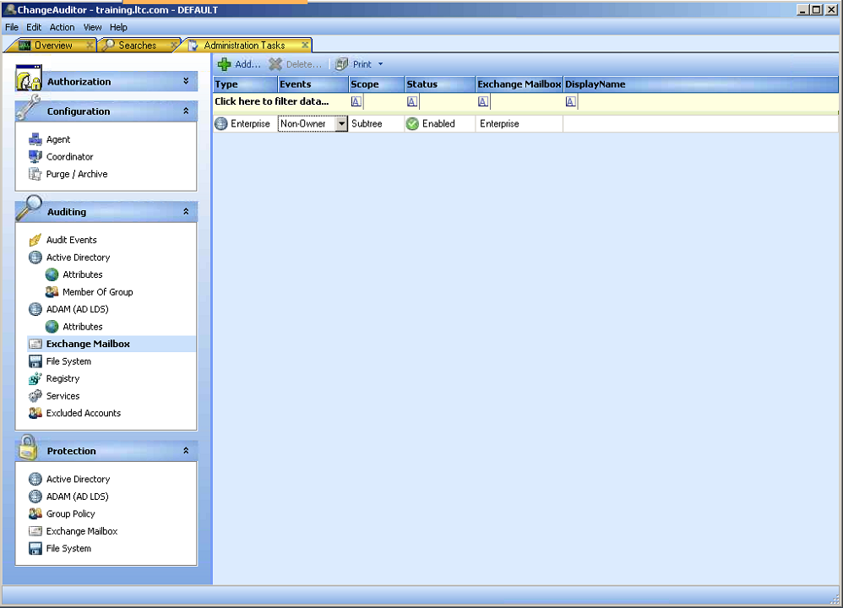
CA Class 1 Exchange
Audit all mailboxes for Non-Owner access.

Slide 66
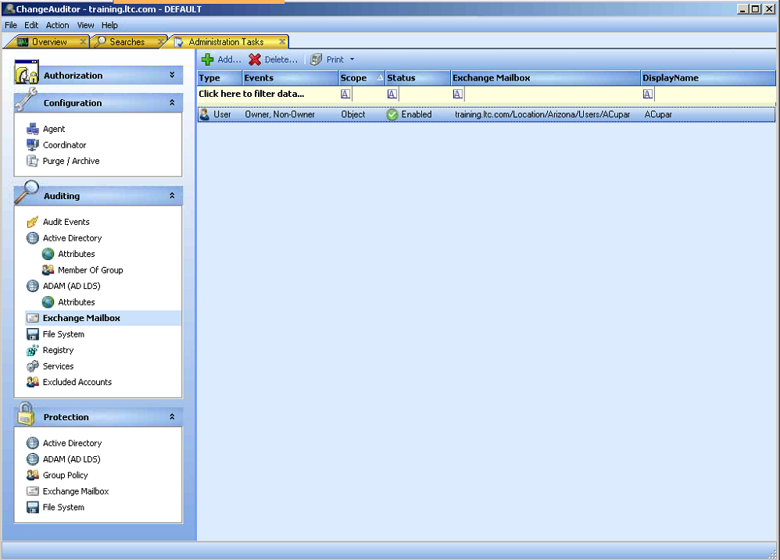
CA Class 1 Exchange
Audit single mailbox for all access.

Slide 67
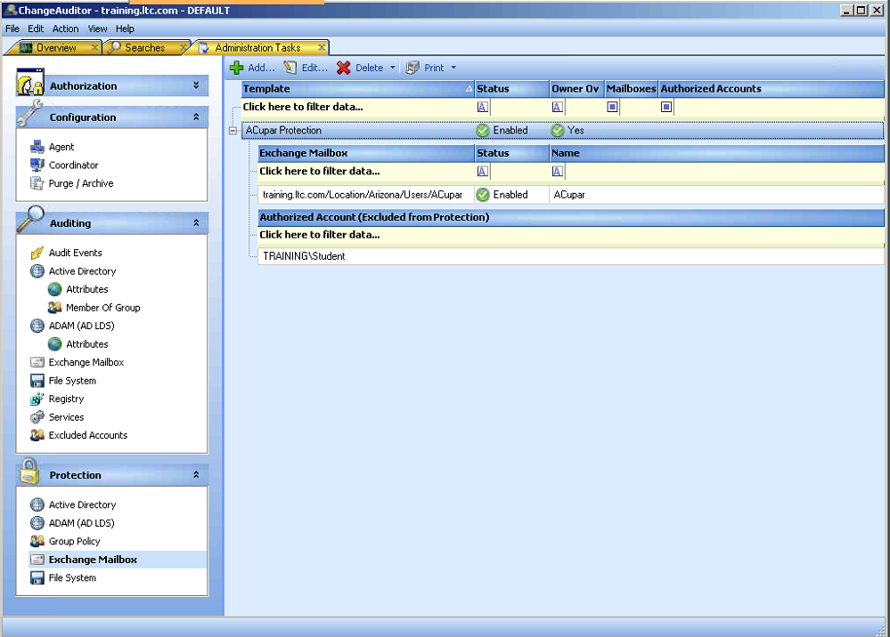
CA Class 1 Exchange
Protect mailbox while allowing owner and one other objects access.

Slide 68
CA Class 1 Lab 6
Mailbox Auditing
To engage mailbox auditing, Open ChangeAuditor and go to the Administration Tasks tab. Here select Exchange Mailbox under Auditing.
First we will turn on non-owner mailbox auditing for the entire enterprise. Click Add…verify that the Enterprise radio button is checked and click Finish.
Note that upon completion the Events column shows a dropdown, but you have no option besides “Non-Owner”.
This will create non-owner events for any access to any mailbox within the enterprise. This is likely more than what is necessary, so we will remove this and be more precise. Highlight Enterprise and click Delete. Now select add again. This time drill down to Location\Arizona\Users\ACupar and click Add; then Finish.
Now if we click the Drop down under Events; we can choose “Non-Owner” or “Owner, Non-Owner” which will monitor all reads of this particular mailbox. For our example, select “Non-Owner”.
Refresh the agent configurations select the local box and click Refresh Configuration.
Now select the other two agents and repeat the process. This time you will need to enter credentials with access to both servers, either admin or exadmin.

Slide 69
CA Class 1 Lab 6
To test the auditing we need to give our Student account access to the ACupar mailbox. RDC into itarscxx with the credentials username exadmin, password leadthem. Once in, open the Exchange Management Console.
Drill into Recipient Configuration and select Mailbox. Then in the right window select ACupar and right mouse click. Here choose “Manage Full Access Permission…”.
Click Add and find your Student account. Then click OK.
Next click “Manage” and verify successful completion. Now click finish.
Return to your main machine. With outlook running right click on the Mailbox then choose “Open Other Folder”-> “Other User’s Folder…”
Enter ACupar in the Name field or the account you choose to control.
Once complete you will have triggered non-owner mailbox activity, which you can view from the Overview page of ChangeAuditor.
Exchange Mailbox Protection
Open the Administration Tasks tab. Here go to Exchange Mailbox under the protection section. On this screen click Add…
You must name the Template, we will call it ACupar protection. Now choose Location\Arizona\Users\ACupar and click Add then Next.

Slide 70
CA Class 1 Lab 6
On the select accounts page, we do not want to select an account but do want to allow the Mailbox owner to bypass protection (almost always a good idea). Now click Finish.
Refresh the agent configurations, select the local box and click Refresh Configuration.
Now select the other two agents and repeat the process. This time you will need to enter credentials with access to both servers, either admin or exadmin.
Now to verify that our permissions are working, go back to Outlook and repeat the process of opening the ACupar mailbox.
Now we want to add an override account to see if we can access the mailbox after that. Highlight ACupar Protection and click Edit… Now click Next and choose your student account from the AD tree. Users\Student and click Add. Then click Finish.
Don’t forget to refresh the Exchange agent configuration.
Now return to Outlook again and connect to the ACupar mailbox.
Now take the Lab 6 test.

Slide 71
CA Class 1 File Systems
Features of ChangeAuditor for File Servers
Auditing of all types of file access (each access type can be turned on or off)
Auditing of all types of folder access (each access type can be turned on or off)
Protection of file systems based on multiple criteria, regardless of actual permissions.
Specific file servers, files, and folders can be audited and protected regardless of windows-based auditing settings.
File Server settings are stored in templates to allow for application to specific servers.

Slide 72
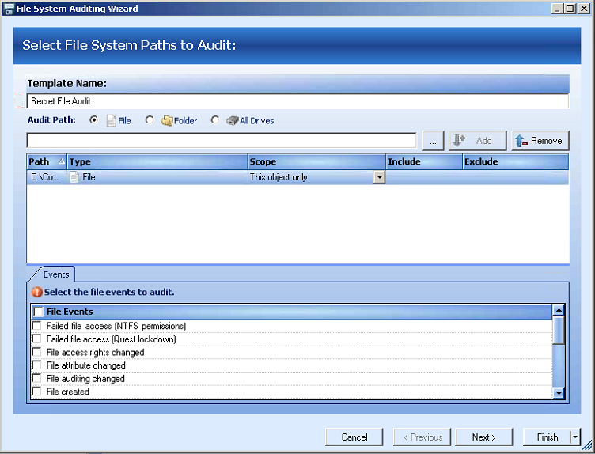
CA Class 1 File Systems
Choose your file access type to monitor.

Slide 73
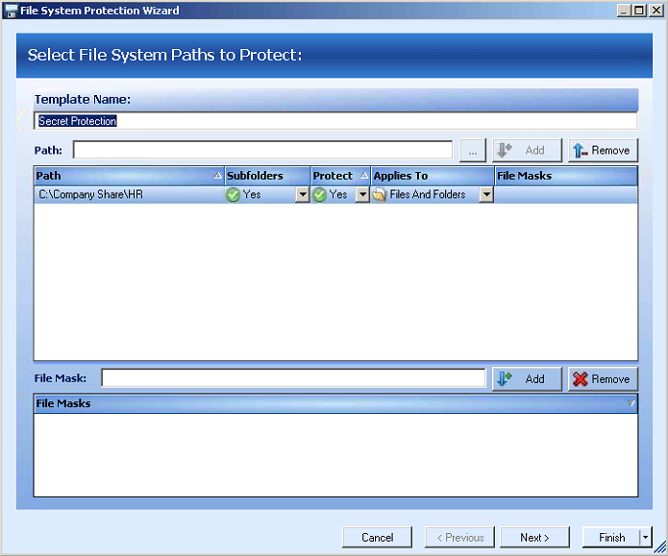
CA Class 1 File Systems
Protecting files and folders can be set to stop all access to any files or just block specific activities.

Slide 74
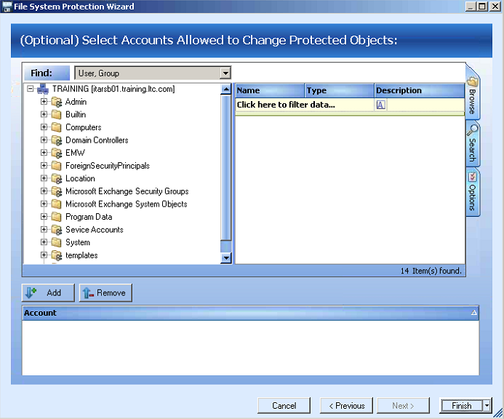
CA Class 1 File Systems
Choose the user accounts that can access and choose the protected objects.

Slide 75
CA Class 1 Lab 7
File System Audit
For File Systems auditing we need to return to the Administration Tasks tab. From this tab select File System under the Auditing section. Then select Add to create a File System audit Template.
Now enter the template name “Secret File Audit”. We will audit a file and the path to the file is C:\Company Share\HR\secret1.txt. Once this is entered click Add.
Now you must select the file events that you want to audit. For our test use: File Deleted; File Opened; and File Ownership changed. Then click Next.
From here we have the ability to select processes that can access the file, but for our purposes we will not add any processes.
At this point we have created a File System audit template. The template will now need to be applied to an agent configuration. Now to apply the template to a specific server we go to configuration and click on Agent. This screen gives you a view of the agents currently running, but it also give you access to the configuration section. Click on Configurations…
Now let’s add a new configuration for Exchange servers. To start, click Add… and then change the name to Company Share Config.

Slide 76
CA Class 1 Lab 7
This screen allows you to control a variety of information on how the coordinator communicates with the agent, but currently we are only concerned with templates. Highlight the Company Share Config name and then adjust the dropdown under Assigned from No to Yes. Then click Apply or OK.
Now we have the configuration ready, but it is still not applied. To assign the new template to the appropriate agent; highlight the agent you need (ITARSBxx) and click on Assign…
Then choose the correct configuration “Company Share Config” and click OK.
Refresh the agent configurations, select the local box and click Refresh Configuration.
Now select the other two agents and repeat the process. This time you will need to enter credentials with access to both servers, either admin or exadmin.
Now to check the auditing, open an RDC connection back to itarsbxx with the admin leadthem credentials. Open windows explorer and open the file c:\company share\HR\secret1.txt.
To verify logging return to your main computer and go to the ChangeAuditor Overview tab. You may need to refresh, but the logged event should be present.

Slide 77
CA Class 1 Lab 7
File System Protection
File system protection is setup very similar to FS auditing. To protect an object you must create a template and then assign it to an agent configuration. To select File System from the protection section; and then click Add..
Now we must set the Template Name, and the path to the file or folder. The template name will be Secret Protection and file is c:\Company Share\HR. Once entered, click Add, then Next.
Here we can drill down and select accounts that are allowed to change the files and folders listed above. We will leave blank for testing and allow no one to edit the files. Click Finish.
Once Finish is clicked we have created another template that will need to be applied just like the file system auditing template. Click on Agent, then Configurations. Highlight the Company Share Config and then assign the file system protection template to that config.
Once assigned here click OK or Apply. Since we have previously assigned the Company Share Config to ITARSBxx; we only need to refresh the configuration.
Now back to ITARSBxx with windows explorer to see if we can open the files in question.
Please take the Lab 7 test.

